Slide 1

Chess Engine
The Good, The Bad, and The Ugly
Shannon Govekar, Xiaorui Li, Prasanth Palli, Matthew Prelich, Xiaobin Ran

Slide 2

Project Goal
Implementing a chess engine from scratch which allow Computer-Human interaction over a graphical user interface. Different search and pruning algorithms will be executed to predict the player’s moves, make the best decision and to optimize time and memory usage.
Notes:
Implementing a chess engine from scratch which plays against a user. We are planning to use a Negamax search approach to evaluate what move to execute by the computer. The key challenge arises from the high average branching factor of 35 for the game of chess, which just allows us to look ahead 4 moves in a reasonable time. To augment this, better heuristics and pruning methods will be considered to prune large parts of the tree and consider only interesting regions. This will enable us to look more steps into the future and help in taking better informed decisions. Alpha-Beta Pruning and Principal Variation Search are some such methods which we are interested in implementing.

Slide 3
Representation & Data Structure
We will start with a 2D graphic representation of the chessboard and pieces, where the user can control the movement of each piece by mouse click. If time permits, ideally we can expand the GUI to 3D.
As for data structures, The chessboard is presented as a 2D array that contains characters representing different pieces and their locations. For example, a black pawn is “p” and a white pawn is ‘P’. Each step creates a new board configuration.
We will also use a tree structure to specify different possibilities and levels of prediction. The root is the current board configuration, and nodes are different possible configurations according to depth/height.

Slide 4
Algorithms
We plan to implement 4 algorithms for this project.
Negamax-Search:
This is the strategy which we want our chess-engine to use while playing against a user. It uses a mini-max criterion to choose the action which minimizes the reward of the opponent’s best action. It evaluates all the possible successor configurations which is usually time-intensive.
2) Alpha-Beta Search:
Alpha-Beta search tries to reduce the search space by deleting branches which could not result in the best-move. This results in a speed-up and thereby allows the chess-engine to look deeper into the tree.
Minimax etymology: minimizing the possible loss for a worst case (maximum loss) scenario
Notes:
Minimax= minimizing the possible loss for a worst case (maximum loss) scenario

Slide 5
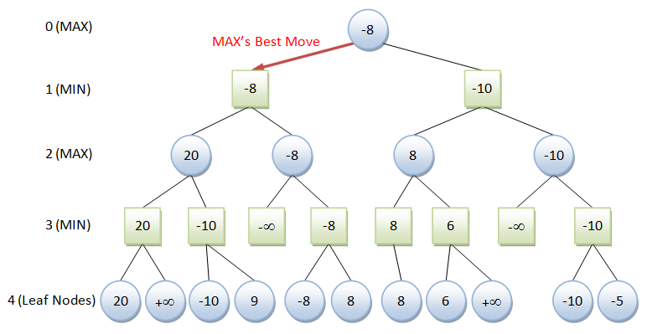
Negamax - Search

Slide 6
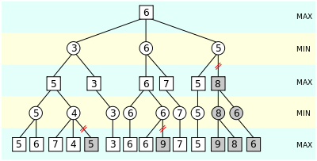
Alpha-Beta Search

Slide 7
Algorithms (continued)
3) Principal Variational Search with Move Ordering:
Principal Variational Search further tries to speed up the search by sequencing the moves to explore. For example, piece captures are given preference over other moves.
4) Iterative Deepening:
We will be implementing iterative deepening search to search the tree level-by-level. By doing this, the chess-engine will always have the best possible action till that depth level.

Slide 8
Stretch Goals
External Library
NULL Move Pruning is simple heuristic technique used to enhance the speed of alpha-beta pruning algorithm. It is designed to guess cutoffs with less effort than otherwise required.
Fssimplewindow
OpenGL

